Slide 1

An introduction to programming concepts with Scratch
(in one week)

Slide 2

Scratch?

Slide 3
What can we do with Scratch?
Learn some computing concepts.
Learn some practical algorithms.
Use Scratch as computing tool.
Have fun with Scratch creating stories, games, art.
Notes:
Algorithms next week

Slide 4
Part I: Looks and Motion
Goals:
Learn Scratch programming environment
Learn the looks and motion menus
Write a sequence of instructions

Slide 5
Create a scratch account
https://scratch.mit.edu/
https://www.linkedin.com/learning/learning-scratch/what-is-scratch
https://www.linkedin.com/learning/learning-scratch/create-a-scratch-account?

Slide 6
Exercise (10 min)
1 Create your own scratch account
2 Find out -What is a Remix in scratch

Slide 7
remix
Flappy bird (https://scratch.mit.edu/projects/880868161/)
Farmer worlds https://scratch.mit.edu/projects/876360891
Agar.io https://scratch.mit.edu/projects/110760232

Slide 8
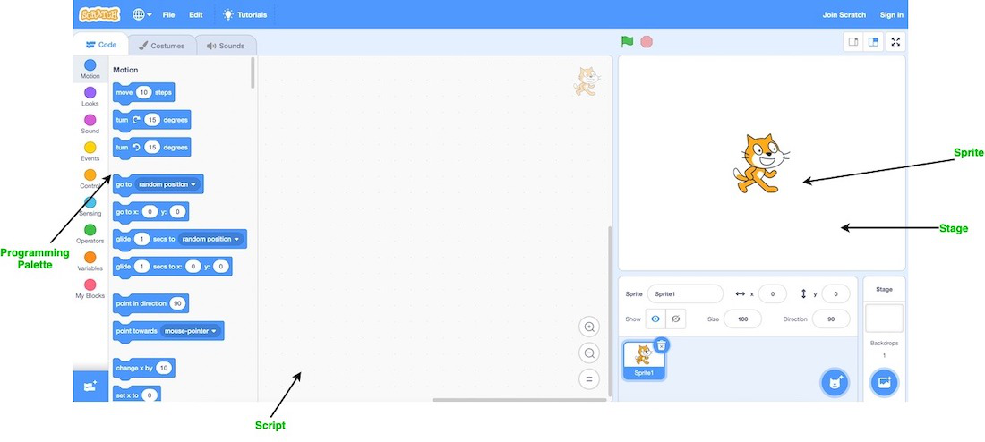
Explore Scratch

Slide 9
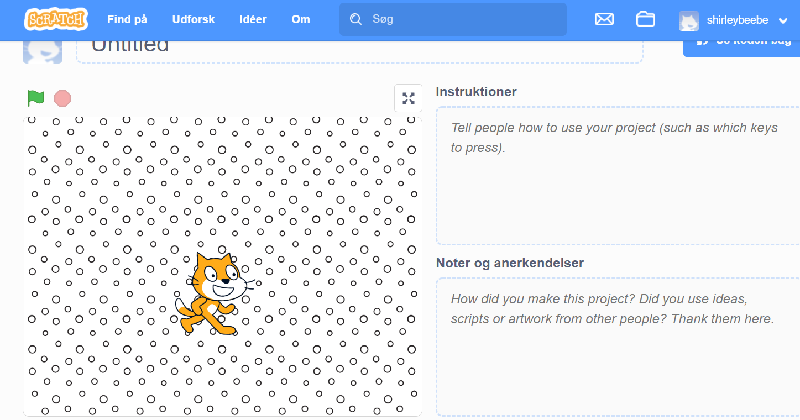

Slide 10

Start scratch
Click on the cat icon
Scratch programming environment comes up
We will first do simple things

Slide 11
Our Scratch environment
Stage is at upper right (where actors act and information is displayed)
Sprite is another name for actor.
Instruction menus/panel at left (instructions for the actors)
A script is another name for program or method; a script tells the actor what to do.
Programming area in center; here is where we construct scripts for the sprites

Slide 12
We start with the cat sprite
We will learn to use many other sprites later. For now we use the cat as our only actor. We script the
BEHAVIOR of our cat.

Slide 13
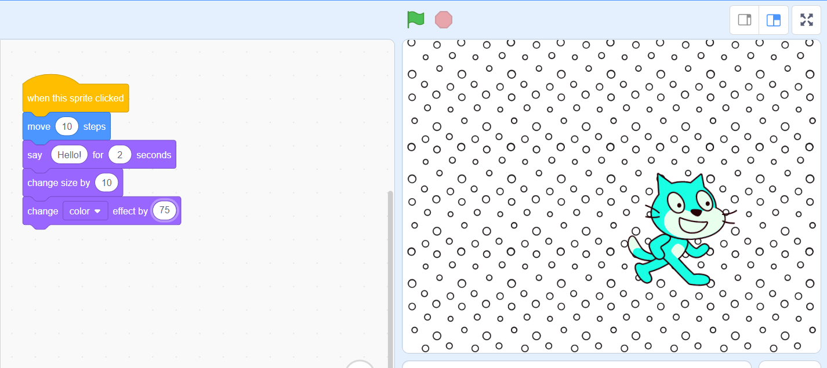
Our script (program)

Slide 14
A sequence or block is a simple program
The first instruction is done first
The second instruction is done second
The last instruction is done last.
(if any one instruction is done, then every on of them is done)

Slide 15
The WAIT instruction
WAIT is needed to slow down the acting so we can see or hear it properly (computers are too fast sometimes)
Get the wait instruction from the CONTROL menu. Ignore the other menu options for now.
Insert a wait in our looks script

Slide 16
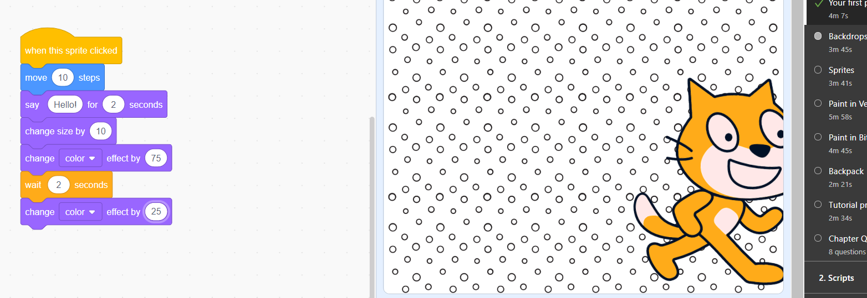
2 second pause between changing color
Notes:
Tip , can use when the flag is clicked in control

Slide 17
Exercise: write a script to do the following
When click start
Double the size of the sprite
Wait 2 seconds
Change the color of the sprite to green
Wait 4 seconds
Change the whirl effect to 100
Say “That’s all folks!”
https://en.scratch-wiki.info/wiki/Graphic_Effect
Notes:
Hint whirl effect is option to color

Slide 18
The MOTION menu
How to locate and orient a sprite; moving a sprite.

Slide 19
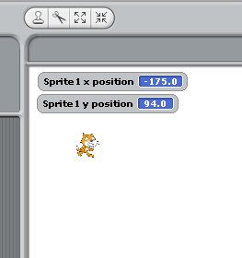
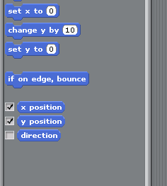
Position on the stage
Click on the
Motion menu.
Click to check the box for x-position and y-position
Drag your cat around and note its x-y position.

Slide 20
Angles and directions
Making your sprite go this way and that way

Slide 21
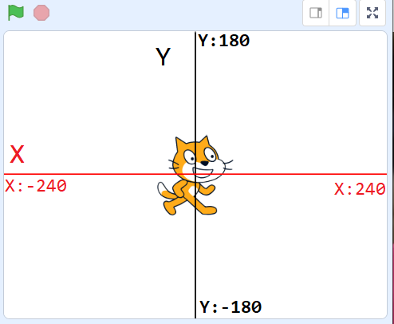
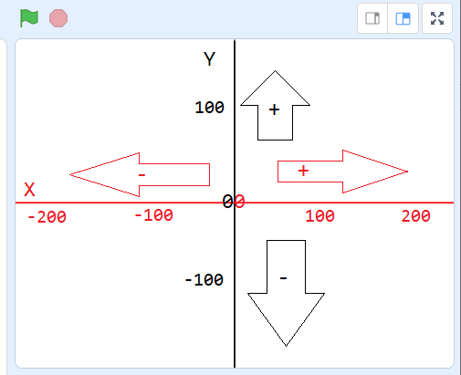
Notes:
https://www.imaginecodecreate.com/scratch/scratch-basics-work-space/

Slide 22
Repetition and Variation
Goals:
Learn how to program with repetition
Learn how to change costumes
Learn to controll execution (behavior) using special keys

Slide 23
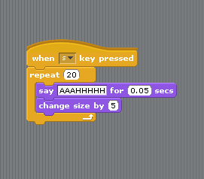
The sneezing cat script
We repeat 20 times
Say “AAAHHHH”
for a short time
Then grow the cat 5 bigger

Slide 24
Exercise: Bring the cat size down to normal
Repeat 20 times Briefly say “CCHHEEEW”
Then shrink the cat’s size by 5
Repeat N times and repeat forever are in the Control menu

Slide 25
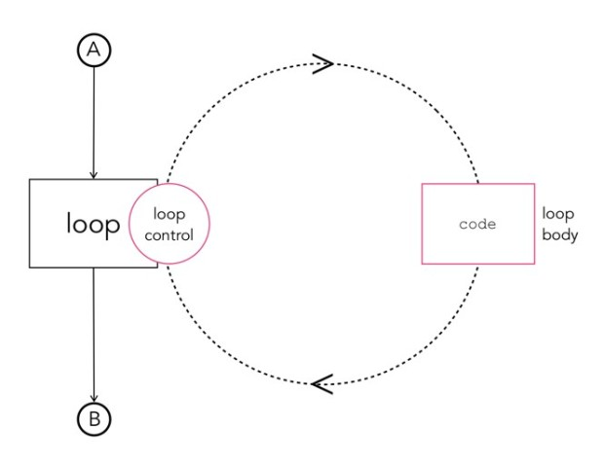
Repeat in programing

Slide 26
Changing costumes
Another way to change the Appearance of a sprite.

Slide 27
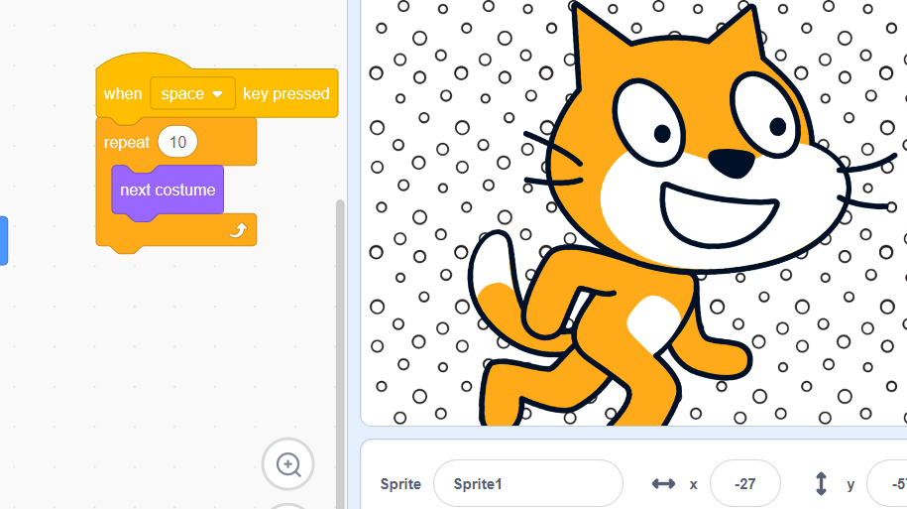
New costume

Slide 28
Changing coordinates
We can randomly set the location of the bat so it will “flutter”.
Set X to a random number
Set Y to a random number
Move the bat to location (X,Y)
Of course, the bat should remain on stage!

Slide 29
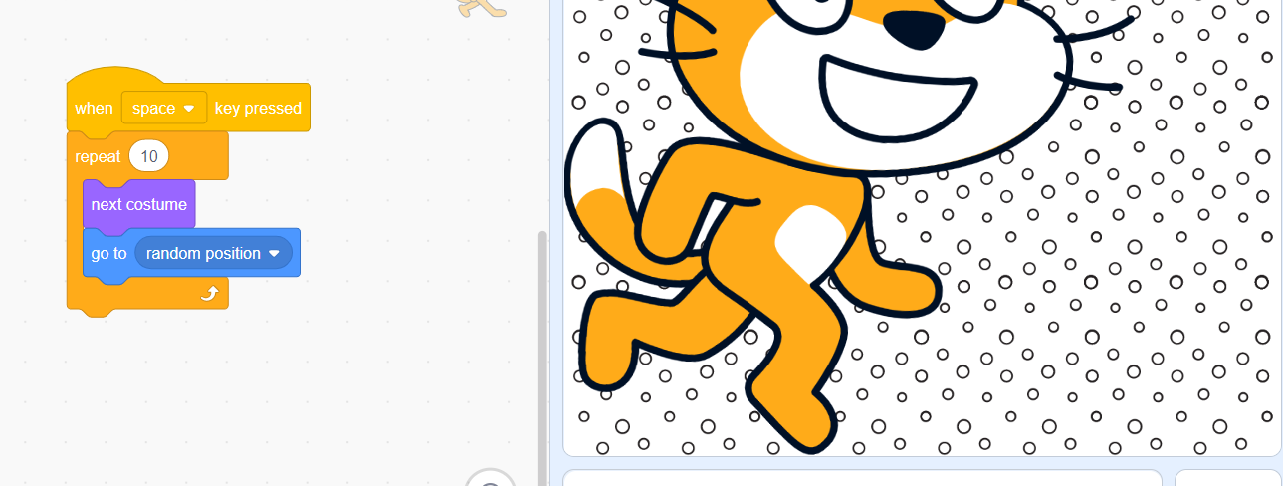
Using pick random
Click the stop sign at the stage upper right to stop the forever loop. Do we need a wait in the loop? Try it to see the changes
Notes:
Can use glide

Slide 30
Controlling the direction of a new Sprite
Make a new Sprite
Let’s create scripts.
Click space bar for random moves
Click right arrow to move right
Click left arrow to move left
Notes:
Point to direction can be used

Slide 31
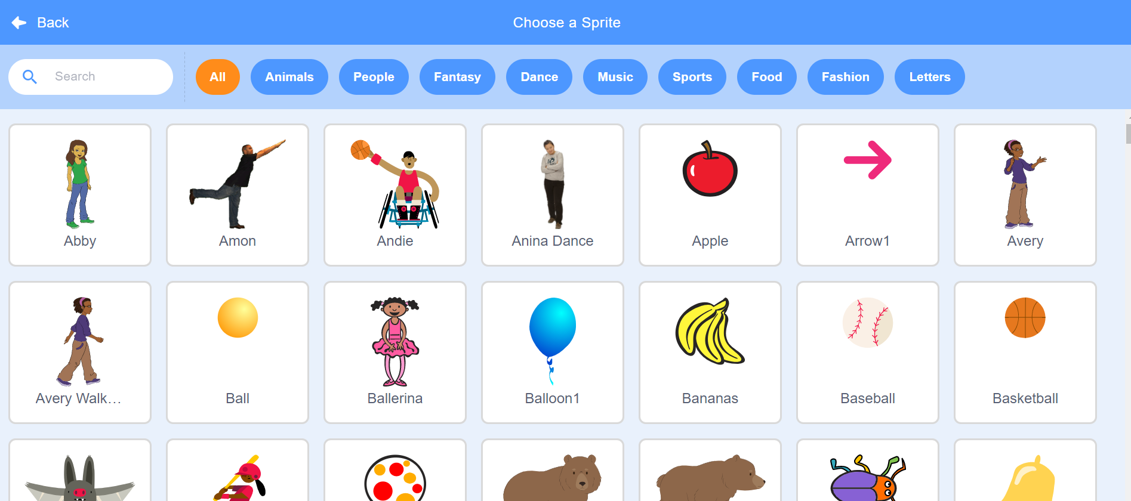
Exercise Change Sprite

Slide 32
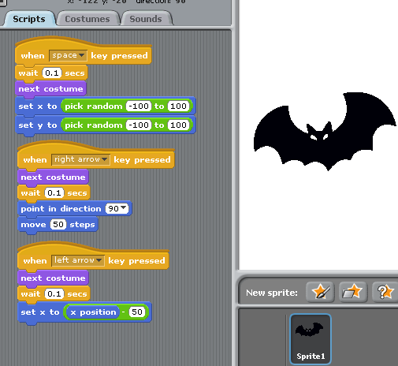
Multiple interactive bat flight
3 different behaviors for the bat
Notes:
https://scratch.mit.edu/projects/560933922

Slide 33
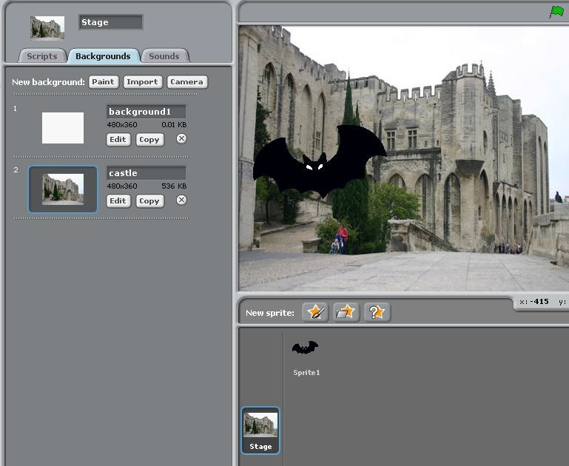
Adding a background
Click on the Stage icon at lower right
Click on
Backgrounds
Click on bat icon (Sprite1)
Click on Scripts
FLY AGAIN!

Slide 34
Exercise:
Add a behavior (script) to move a sprite up with the up arrow.
Add a behavior to move the sprite down with the down arrow.
Add more behavior …

Slide 35
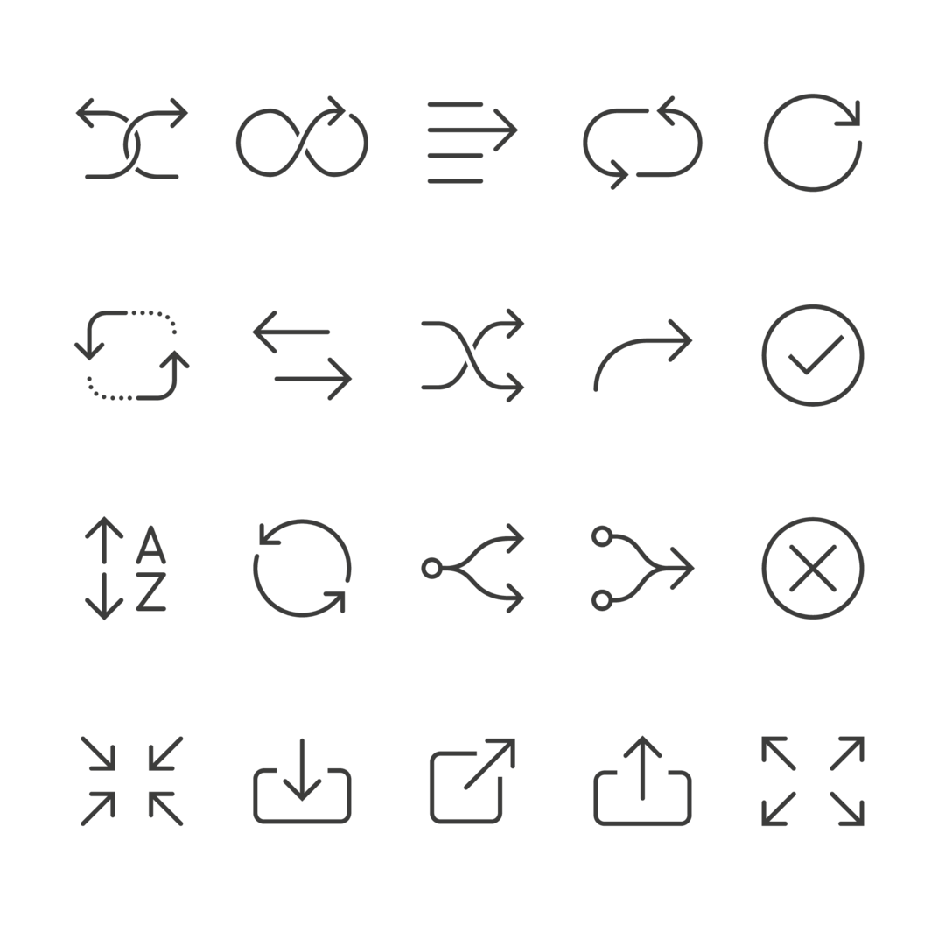
Part : control statement-if

Slide 36
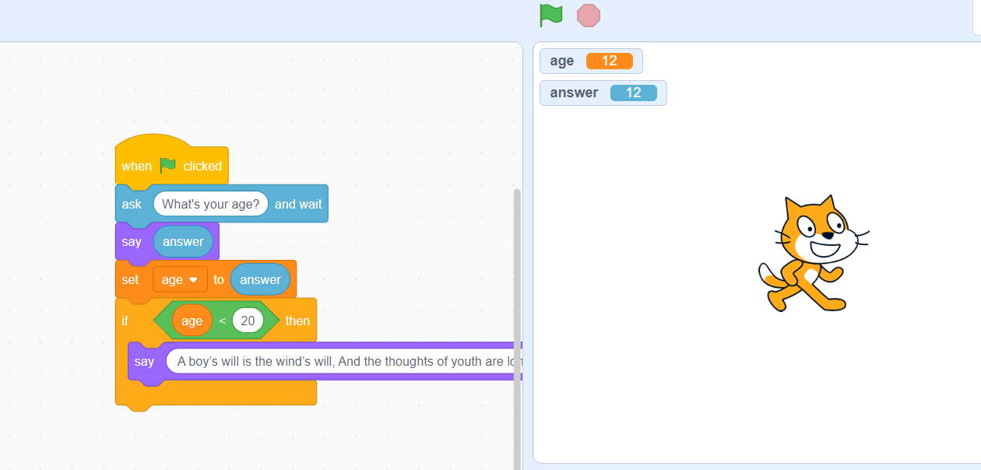
Notes:
https://scratch.mit.edu/projects/560932980

Slide 37
Quiz time. Scratch

Slide 38
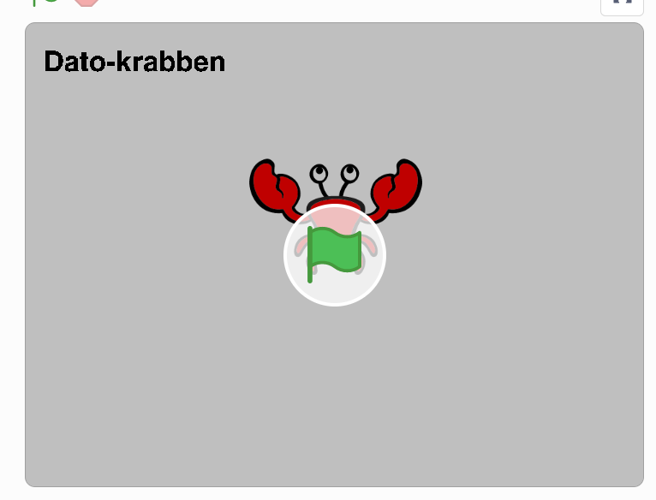
metoder/function (demo) – My blocks
https://scratch.mit.edu/projects/528844438
Notes:
https://scratch.mit.edu/projects/528844438

Slide 39
Extra opgave
Fodbold bane løsning
https://scratch.mit.edu/projects/728658353
Se
Scratch_fredag.docx

Slide 40

PPT Time –30 min
Explain in your own words with your examples in Scratch
Programming paradigms
programming paradigms
1 Event driven (hint
https://www.linkedin.com/learning/learning-scratch/detect-collisions?resume=false
)
2 Functional programming
(hint slide 41)
3 Procedural programming
4 Objektorienteret programmering (OOP)

Slide 41
Plan til næste uge- tirsdag
1 Fodbold bane- linkedin video gå igennem
2 Game Theori
3 Game Udvikling

